Slide 1
Kubernetes(k8s)

Slide 2
POD
A Pod is the basic execution unit of a Kubernetes application--the smallest and simplest unit in the Kubernetes object model that you create or deploy. A Pod represents processes running on your cluster.
A Pod encapsulates an application's container (or, in some cases, multiple containers), storage resources, a unique network identity (IP address), as well as options that govern how the container(s) should run. A Pod represents a unit of deployment: a single instance of an application in Kubernetes, which might consist of either a single container or a small number of containers that are tightly coupled and that share resources.
POD Life Cycle :
Value | Description
Pending | The Pod has been accepted by the Kubernetes system, but one or more of the Container images has not been created. This includes time before being scheduled as well as time spent downloading images over the network, which could take a while.
Running | The Pod has been bound to a node, and all of the Containers have been created. At least one Container is still running, or is in the process of starting or restarting.
Succeeded | All Containers in the Pod have terminated in success, and will not be restarted.
Failed | All Containers in the Pod have terminated, and at least one Container has terminated in failure. That is, the Container either exited with non-zero status or was terminated by the system.
Unknown | For some reason the state of the Pod could not be obtained, typically due to an error in communicating with the host of the Pod.

Slide 3
--->Pod:
appVersion: v1
kind: Pod
metadata:
name: pod_1
lables:
name: nginx-1
type: frontend
app: nginx
spec:
containers:
- name: nginx
image: nginx
- name: tomcat
image: tomcat
Get ll pods in default namespace
$kubectl get pods Create nginx pod with image nginx
$kubectl run nginx –image=nginx
How to know which image used to create nginx pod
$kubectl describe pod nginx
How to know which pods are placed on which nodes
$kubectl get pods –o wide
Find out number of containers per pod
$kubectl describe pod <podname>
Delete pod
$kubectl delete <pod_name>
How to update pod definition file
$kubectl edit pod <pod_name>
$kubectl get pod <pod_name> -o yaml > pod.yaml(to write as yaml file)

Slide 4
Service
An abstract way to expose an application running on a set of Pods as a network service.
With Kubernetes you don't need to modify your application to use an unfamiliar service discovery mechanism. Kubernetes gives Pods their own IP addresses and a single DNS name for a set of Pods, and can load-balance across them
In Kubernetes, a Service is an abstraction which defines a logical set of Pods and a policy by which to access them (sometimes this pattern is called a micro-service). The set of Pods targeted by a Service is usually determined by a selector (see below for why you might want a Service without a selector).
For example, consider a stateless image-processing backend which is running with 3 replicas. Those replicas are fungible—frontends do not care which backend they use. While the actual Pods that compose the backend set may change, the frontend clients should not need to be aware of that, nor should they need to keep track of the set of backends themselves.
The Service abstraction enables this decoupling

Slide 5
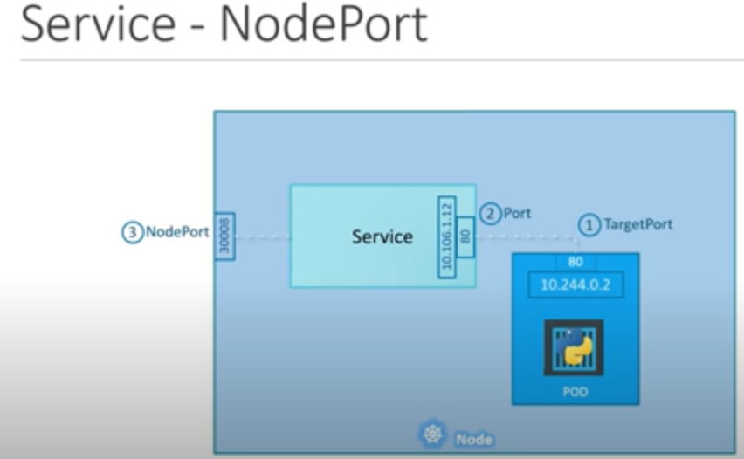
There are 3 types of services.
NodePort
ClusterIP
Loadbalancer
nodePort:
NodePort is common/basic service type using which we could expose our application to the external world. In the below case , suppose we have niginx application which is running at port 80 (TargetPort) and mapping to 80 (Port) under Service objecet and then mapping to 30008 (NodePort) on Machine level ports and available port range is 30000 to 37000. Below we could see a single POD that run nigin app.

Slide 6
apiVersion: v1
kind: Service
metadata:
labels:
name: mysql
name: mysql
spec:
ports:
# the port that this service should serve on
- port: 3306
# label keys and values that must match in order to receive traffic for this service
selector:
name: mysql
apiVersion: v1
kind: Service
metadata:
name: voting-service
labels:
name: voting-service
app: demo-voting-app
spec:
ports:
- port: 80
targetPort: 80
type: LoadBalancer
selector:
name: voting-app-pod
app: demo-voting-app

Slide 7
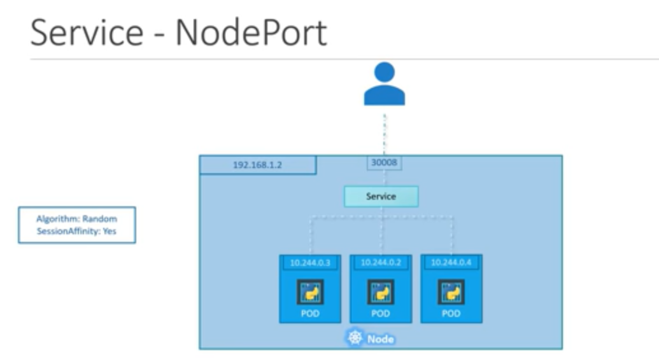
Below is the case where we have multiple PODS running/serving the same app assume that nginx running port 80 (TargetPort). Service Object itselft acts as loabalancer and distirbutes load across all the three PODs. This acts itself a inbuild Load Balancer and uses something called Algorithm: Random SessionAffinity: Yes. Note: Label should be the same across all the PODs

Slide 8
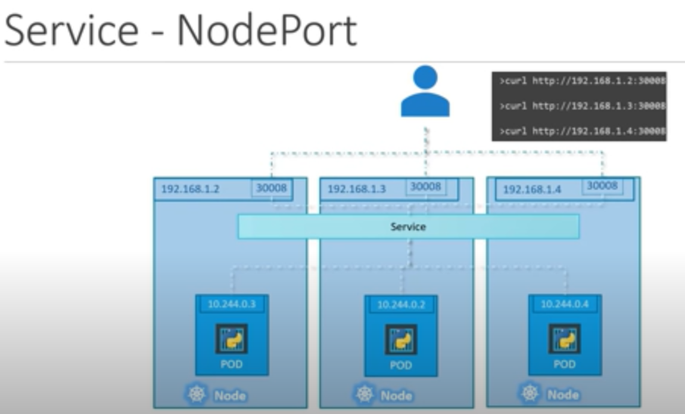
Below is the case where we deployed three same kind of nginx app running at TargetPort(80) in three different machine. In this case Service object acts LB and fulfill the incoming requests. We can ping our request using any of the cluster IP like mentioned below.

Slide 9
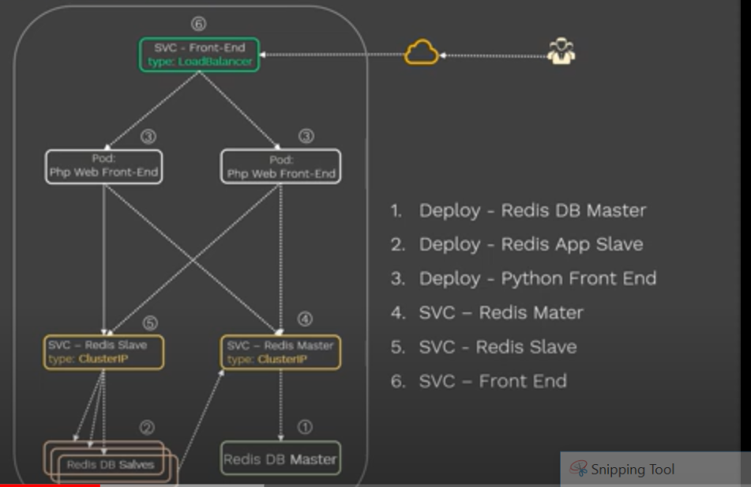
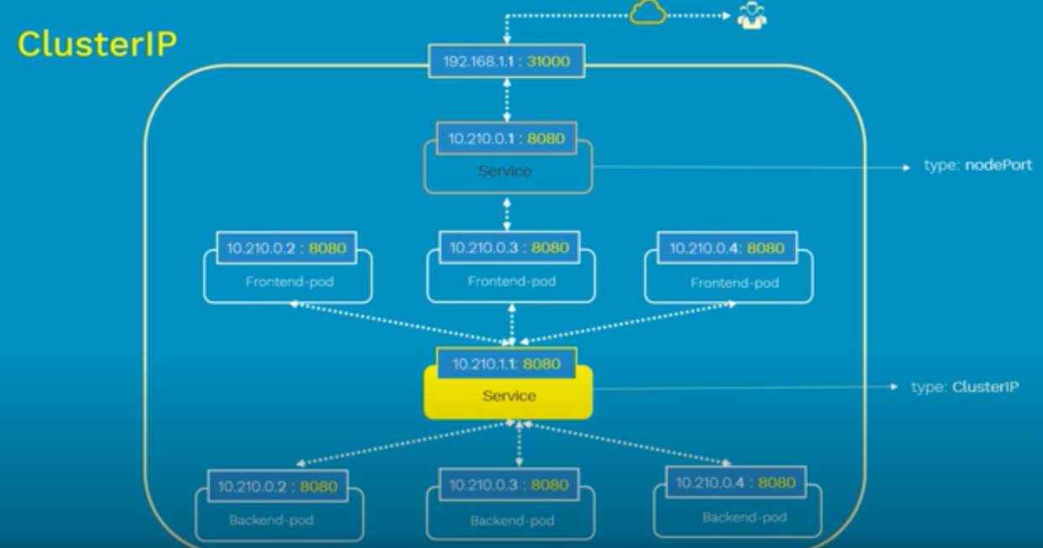
ClusterIP: It is a case where we would like expose the service with in the host, suppose connecting DB instances.

Slide 10
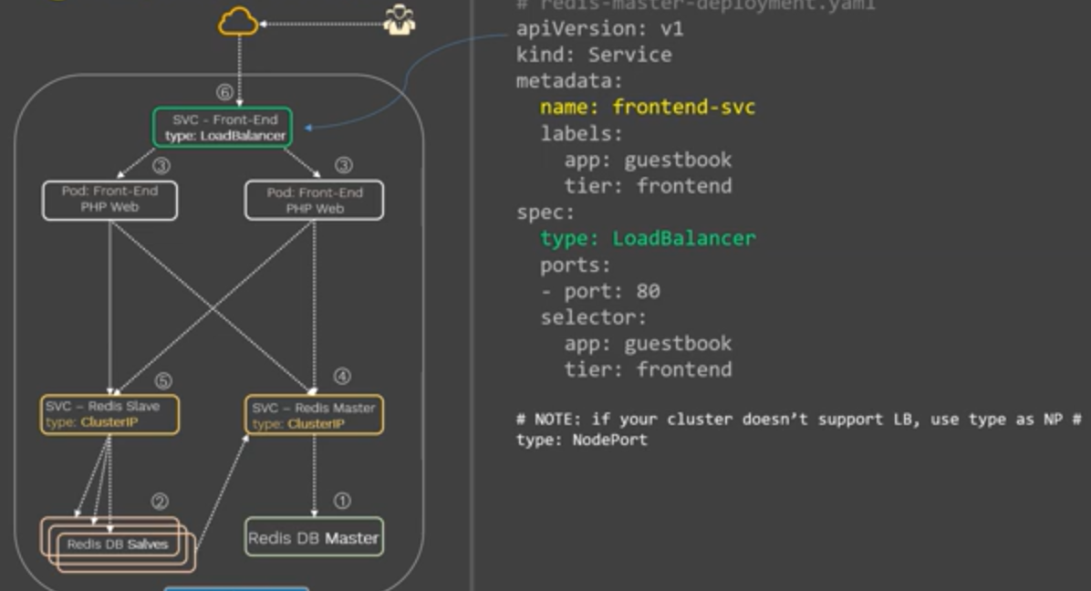
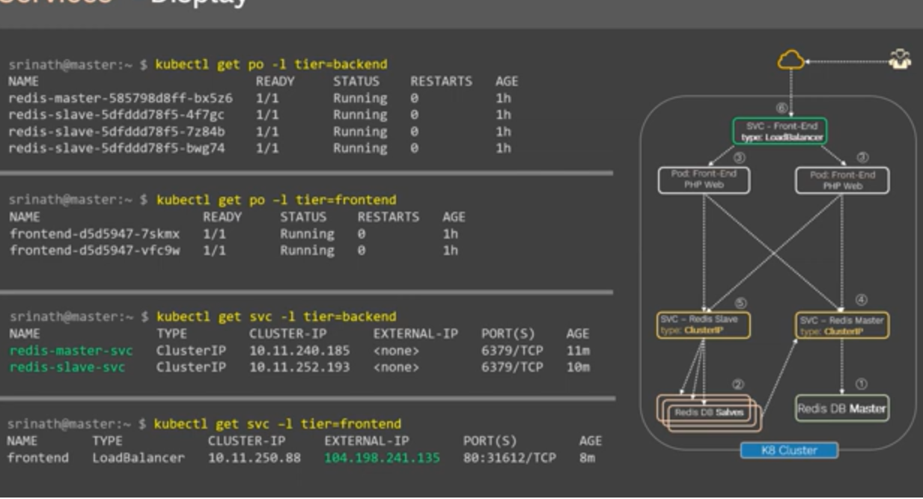

Slide 11
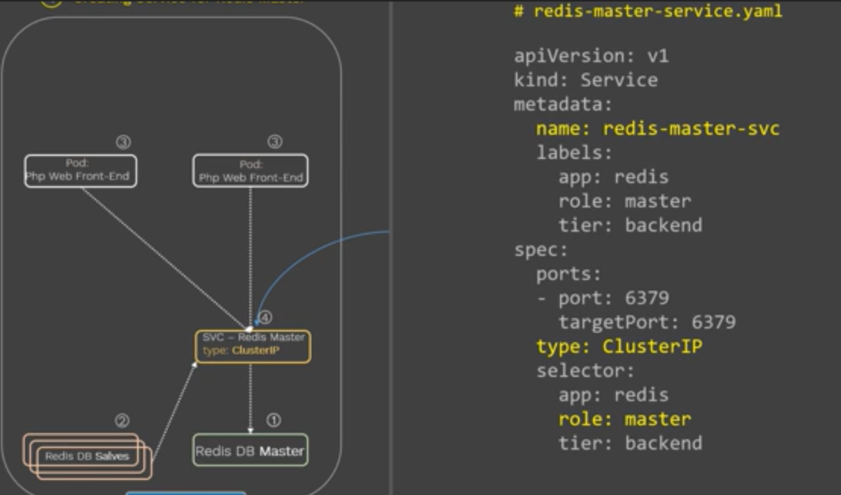
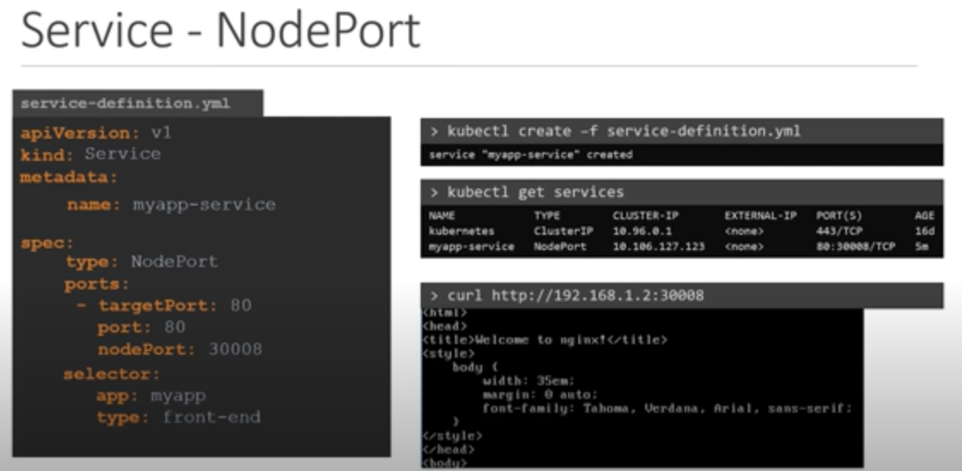

Slide 12
Deployments
A Deployment provides declarative updates for Pods and ReplicaSets.
You describe a desired state in a Deployment, and the Deployment Controller changes the actual state to the desired state at a controlled rate. You can define Deployments to create new ReplicaSets, or to remove existing Deployments and adopt all their resources with new Deployments.
The following are typical use cases for Deployments:
Create a Deployment to rollout a ReplicaSet. The ReplicaSet creates Pods in the background. Check the status of the rollout to see if it succeeds or not.
Declare the new state of the Pods by updating the PodTemplateSpec of the Deployment. A new ReplicaSet is created and the Deployment manages moving the Pods from the old ReplicaSet to the new one at a controlled rate. Each new ReplicaSet updates the revision of the Deployment.
Rollback to an earlier Deployment revision if the current state of the Deployment is not stable. Each rollback updates the revision of the Deployment.
Scale up the Deployment to facilitate more load.
Pause the Deployment to apply multiple fixes to its PodTemplateSpec and then resume it to start a new rollout.
Use the status of the Deployment as an indicator that a rollout has stuck.
Clean up older ReplicaSets that you don't need anymore

Slide 13
apiVersion: apps/v1
kind: Deployment
metadata:
name: nginx-deployment
labels:
app: nginx
spec:
replicas: 3
selector:
matchLabels:
app: nginx
template:
metadata:
labels:
app: nginx
spec:
containers:
- name: nginx
image: nginx:1.14.2
ports:
- containerPort: 80
kubectl apply -f https://k8s.io/examples/controllers/nginx-deployment.yaml
Kubectl apply –f nginx-deployment.yaml
kubectl get deployments
kubectl get deployment nginx-deployment
kubectl describe deployments
kubectl get rs
kubectl get pods --show-labels
Let's update the nginx Pods to use the nginx:1.16.1 image instead of the nginx:1.14.2 image
kubectl --record deployment.apps/nginx-deployment set image deployment.v1.apps/nginx-deployment nginx=nginx:1.16.1
kubectl set image deployment/nginx-deployment nginx=nginx:1.16.1 –record
kubectl edit deployment.v1.apps/nginx-deployment
kubectl rollout status deployment.v1.apps/nginx-deployment
kubectl rollout history deployment.v1.apps/nginx-deployment
kubectl rollout history deployment.v1.apps/nginx-deployment --revision=2 (to see the details of a particular version)
kubectl rollout undo deployment.v1.apps/nginx-deployment
kubectl rollout undo deployment.v1.apps/nginx-deployment --to-revision=2 (particular version)
kubectl scale deployment.v1.apps/nginx-deployment --replicas=10 (scaling to 10)

Slide 14
Assuming horizontal Pod autoscaling is enabled in your cluster, you can setup an autoscaler for your Deployment and choose the minimum and maximum number of Pods you want to run based on the CPU utilization of your existing Pods.
kubectl autoscale deployment.v1.apps/nginx-deployment --min=10 --max=15 --cpu-percent=80
kubectl get deploy
kubectl rollout pause deployment.v1.apps/nginx-deployment
kubectl get rs -w (to see the status until its done, here w stands for watch)
The following kubectl command sets the spec with progressDeadlineSeconds to make the controller report lack of progress for a Deployment after 10 minutes:
kubectl patch deployment.v1.apps/nginx-deployment -p '{"spec":{"progressDeadlineSeconds":600}}'

Slide 15
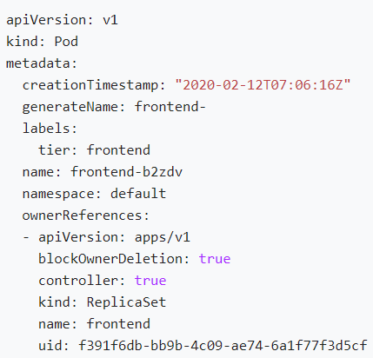
ReplicaSet
A ReplicaSet's purpose is to maintain a stable set of replica Pods running at any given time. As such, it is often used to guarantee the availability of a specified number of identical Pods
A ReplicaSet is defined with fields, including a selector that specifies how to identify Pods it can acquire, a number of replicas indicating how many Pods it should be maintaining, and a pod template specifying the data of new Pods it should create to meet the number of replicas criteria. A ReplicaSet then fulfills its purpose by creating and deleting Pods as needed to reach the desired number. When a ReplicaSet needs to create new Pods, it uses its Pod template.
Commands:
kubectl apply -f https://kubernetes.io/examples/controllers/frontend.yaml
kubectl get rs
kubectl describe rs/frontend
You can also verify that the owner reference of these pods is set to the frontend ReplicaSet.
To do this, get the yaml of one of the Pods running: → kubectl get pods frontend-b2zdv -o yaml
The side image is the output

Slide 16
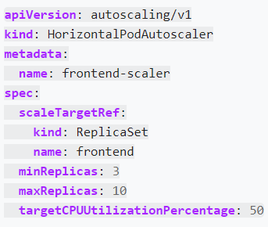
A ReplicaSet can also be a target for Horizontal Pod Autoscalers (HPA). That is, a ReplicaSet can be auto-scaled by an HPA. Here is an example HPA targeting the ReplicaSet we created in the previous example.
Saving this manifest into hpa-rs.yaml and submitting it to a Kubernetes cluster should create the defined HPA that autoscales the target ReplicaSet depending on the CPU usage of the replicated Pods.
kubectl apply -f https://k8s.io/examples/controllers/hpa-rs.yaml
kubectl autoscale rs frontend --max=10 --min=3 --cpu-percent=50

Slide 17
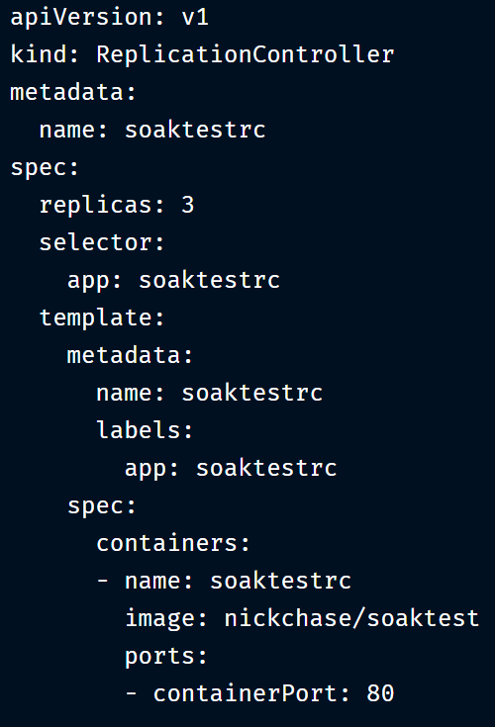
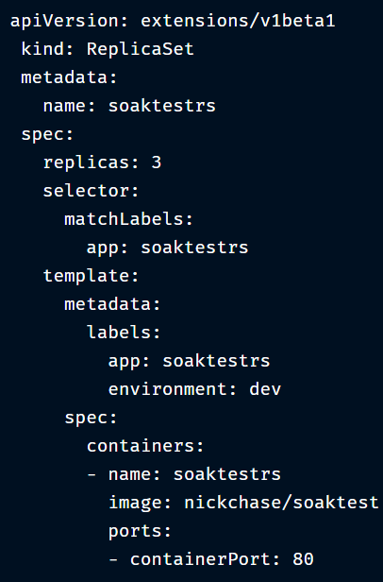
Replication Controller
A ReplicationController ensures that a specified number of pod replicas are running at any one time. In other words, a ReplicationController makes sure that a pod or a homogeneous set of pods is always up and available
kubectl describe replicationcontrollers/nginx
ReplicaSet is the next-generation ReplicationController that supports the new set-based label selector. It’s mainly used by Deployment as a mechanism to orchestrate pod creation, deletion and updates. Note that we recommend using Deployments instead of directly using Replica Sets, unless you require custom update orchestration or don’t require updates at all
Replica Set and Replication Controller do almost the same thing. Both of them ensure that a specified number of pod replicas are running at any given time. The difference comes with the usage of selectors to replicate pods. Replica Set use Set-Based selectors while replication controllers use Equity-Based selectors.

Slide 18
StatefulSets
StatefulSet is the workload API object used to manage stateful applications.
Manages the deployment and scaling of a set of Pods, and provides guarantees about the ordering and uniqueness of these Pods.
Like a Deployment, a StatefulSet manages Pods that are based on an identical container spec. Unlike a Deployment, a StatefulSet maintains a sticky identity for each of their Pods. These pods are created from the same spec, but are not interchangeable: each has a persistent identifier that it maintains across any rescheduling.
If you want to use storage volumes to provide persistence for your workload, you can use a StatefulSet as part of the solution. Although individual Pods in a StatefulSet are susceptible to failure, the persistent Pod identifiers make it easier to match existing volumes to the new Pods that replace any that have failed.
StatefulSets are valuable for applications that require one or more of the following.
Stable, unique network identifiers.
Stable, persistent storage.
Ordered, graceful deployment and scaling.
Ordered, automated rolling updates.

Slide 19
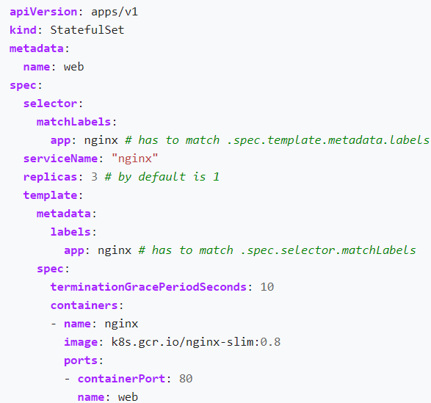
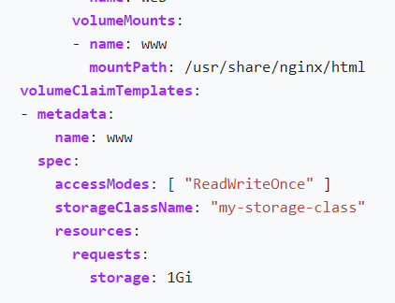
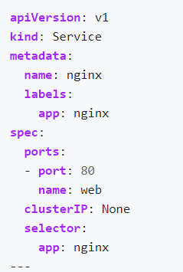

Slide 20
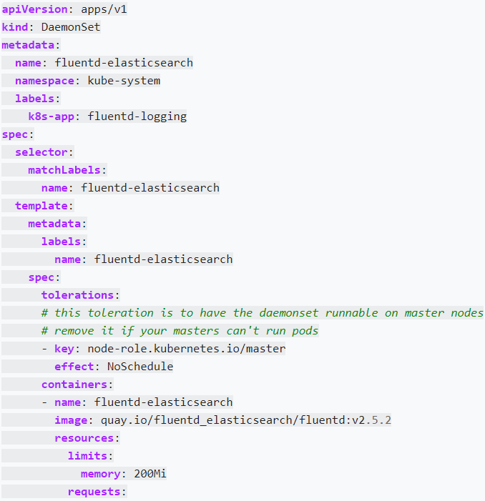
DaemonSet
A DaemonSet ensures that all (or some) Nodes run a copy of a Pod. As nodes are added to the cluster, Pods are added to them. As nodes are removed from the cluster, those Pods are garbage collected. Deleting a DaemonSet will clean up the Pods it created.
Some typical uses of a DaemonSet are:
running a cluster storage daemon on every node
running a logs collection daemon on every node
running a node monitoring daemon on every node
In a simple case, one DaemonSet, covering all nodes, would be used for each type of daemon. A more complex setup might use multiple DaemonSets for a single type of daemon, but with different flags and/or different memory and cpu requests for different hardware types
Ref: https://kubernetes.io/docs/concepts/workloads/controllers/daemonset/

Slide 21
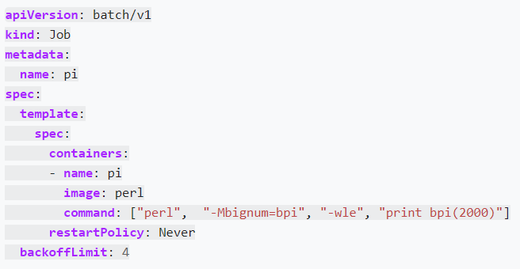
Jobs
A Job creates one or more Pods and ensures that a specified number of them successfully terminate. As pods successfully complete, the Job tracks the successful completions. When a specified number of successful completions is reached, the task (ie, Job) is complete. Deleting a Job will clean up the Pods it created.
A simple case is to create one Job object in order to reliably run one Pod to completion. The Job object will start a new Pod if the first Pod fails or is deleted (for example due to a node hardware failure or a node reboot).
You can also use a Job to run multiple Pods in parallel
kubectl describe jobs/pi
To list all the Pods that belong to a Job in a machine readable form, you can use a command like this.
pods=$(kubectl get pods --selector=job-name=pi --output=jsonpath='{.items[*].metadata.name}')

Slide 22
Namespaces
Kubernetes supports multiple virtual clusters backed by the same physical cluster. These virtual clusters are called namespaces.
Namespaces are intended for use in environments with many users spread across multiple teams, or projects. For clusters with a few to tens of users, you should not need to create or think about namespaces at all. Start using namespaces when you need the features they provide.
kubectl get namespace
kubectl run nginx --image=nginx --namespace=<insert-namespace-name-here>
kubectl get pods --namespace=<insert-namespace-name-here>
You can permanently save the namespace for all subsequent kubectl commands in that context.
that means we can switch to namespace
kubectl config set-context --current --namespace=<insert-namespace-name-here>
# Validate it
kubectl config view --minify | grep namespace:
To see which Kubernetes resources are and aren't in a namespace:
# In a namespace
kubectl api-resources --namespaced=true
# Not in a namespace
kubectl api-resources --namespaced=false

Slide 23
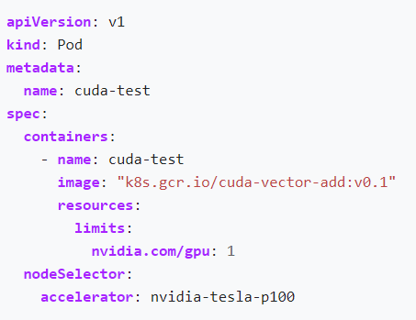
Label & Selectors
Labels are key/value pairs that are attached to objects, such as pods. Labels are intended to be used to specify identifying attributes of objects that are meaningful and relevant to users, but do not directly imply semantics to the core system. Labels can be used to organize and to select subsets of objects. Labels can be attached to objects at creation time and subsequently added and modified at any time. Each object can have a set of key/value labels defined. Each Key must be unique for a given object.
Two types of lables are there.
Equality-based requirement: Equality- or inequality-based requirements allow filtering by label keys and values. Matching objects must satisfy all of the specified label constraints, though they may have additional labels as well. Three kinds of operators are admitted =,==,!=. The first two represent equality (and are simply synonyms), while the latter represents inequality. For example:
One usage scenario for equality-based label requirement is for Pods to specify node selection criteria. For example, the sample Pod below selects nodes with the label "accelerator=nvidia-tesla-p100".

Slide 24
2. Set-based requirement
Set-based label requirements allow filtering keys according to a set of values. Three kinds of operators are supported: in,notin and exists (only the key identifier). For example:
environment in (production, qa)
tier notin (frontend, backend)
partition
!partition
matchLabels is a map of {key,value} pairs. A single {key,value} in the matchLabels map is equivalent to an element of matchExpressions, whose key field is "key", the operator is "In", and the values array contains only "value". matchExpressions is a list of pod selector requirements. Valid operators include In, NotIn, Exists, and DoesNotExist. The values set must be non-empty in the case of In and NotIn. All of the requirements, from both matchLabels and matchExpressions are ANDed together -- they must all be

Slide 25
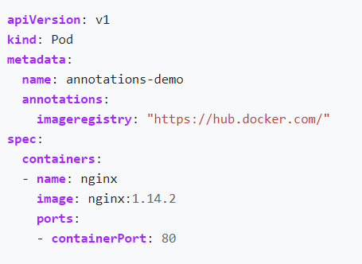
Annotations
You can use Kubernetes annotations to attach arbitrary non-identifying metadata to objects. Clients such as tools and libraries can retrieve this metadata.
For example, here’s the configuration file for a Pod that has the annotation imageregistry: https://hub.docker.com/ :
Use cases:
Build, release, or image information like timestamps, release IDs, git branch, PR numbers, image hashes, and registry address.
Pointers to logging, monitoring, analytics, or audit repositories.
Client library or tool information that can be used for debugging purposes: for example, name, version, and build information.

Slide 26
Resource Quota
When several users or teams share a cluster with a fixed number of nodes, there is a concern that one team could use more than its fair share of resources.
Resource quotas are a tool for administrators to address this concern.
A resource quota, defined by a ResourceQuota object, provides constraints that limit aggregate resource consumption per namespace. It can limit the quantity of objects that can be created in a namespace by type, as well as the total amount of compute resources that may be consumed by resources in that project.
Ref links: https://sysdig.com/blog/kubernetes-limits-requests/
https://kubernetes.io/docs/concepts/policy/resource-quotas/

Slide 27
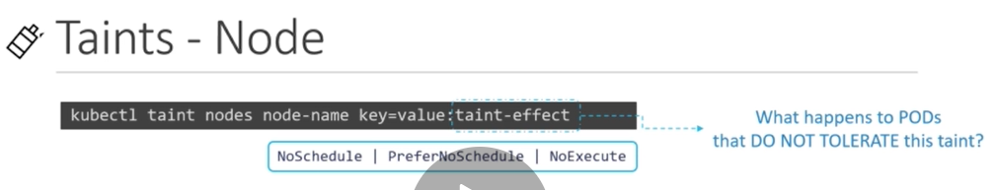
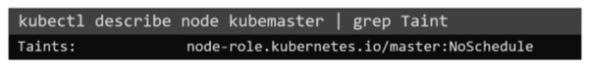
Taints and Tolerants
Taints and tolerants: Taints set on nodes, tolerants set on pods
Kubectl taint nodes node-name key=value:taint-effect
NoSchedule: New pods will not be scheduled on nodes which are not having the toleration in yaml file. It wont evict the existing pods
PreferNoScheule: system will try to avoid not deploying the new pods which are not having toleration, but that is not guaranteed
NoExecute: New pods will be scheduled with tolerations, existing pods will be evicted from node
Ex: kubectl taint nodes node1 app=blue:NoSchdule
No pods will be scheduled on the master nodes because taint mechanism already ser up for master
Biggest difference: will deploy pod on other untainted nodes also. This will overcome by node affinity
How to untaint a node
sudo kubectl taint nodes --all node-role.kubernetes.io/master-

Slide 28
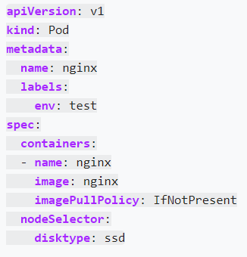
Node Selectors
Node Selectors:
NodeSelector is the simplest recommended form of node selection constraint. nodeSelector is a field of Pod Spec. It specifies a map of key-value pairs. For the pod to be eligible to run on a node, the node must have each of the indicated key-value pairs as labels (it can have additional labels as well). The most common usage is one key-value pair.
This will tell scheduler to deploy pods on which node using labels concept
Here the key and value of the node is “size=Large” same details we will use in yaml file.
Kubectl label nodes <node-name> <label-key>=<label-value>
Kubeclt lable nodes node-1 disktype=ssd
kubectl get nodes --show-labels

Slide 29
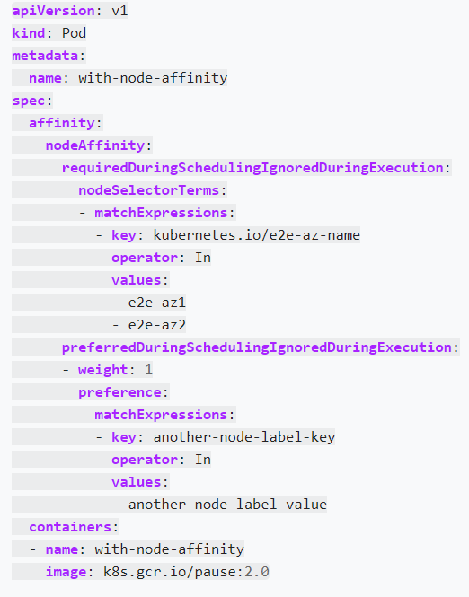
Node affinity
Node Affinity: This shows how to assign a Kubernetes Pod to a particular node using Node Affinity in a Kubernetes cluster. This is based on the label of the node. The same should be inserted in yaml file
kubectl get nodes --show-labels

Slide 30

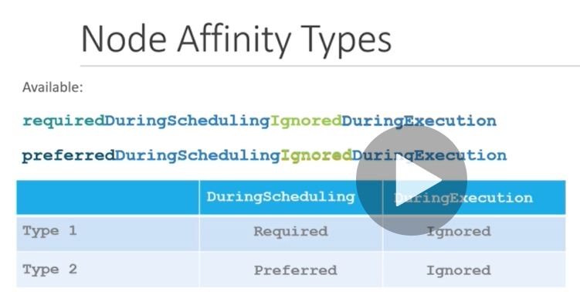
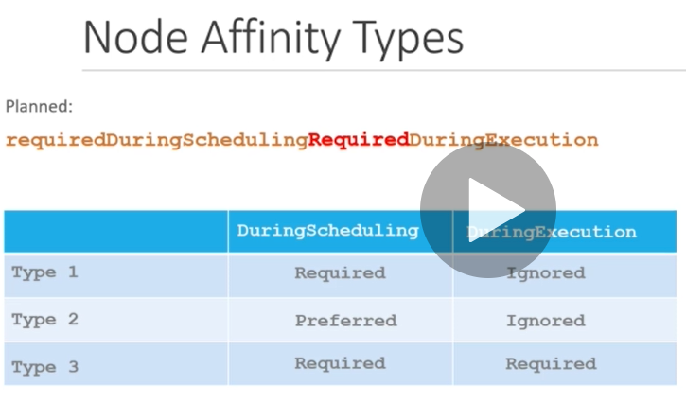
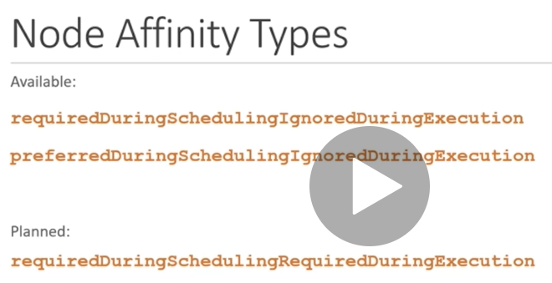
All depends on the affinity sentence. If we say rquiredDuringScheduilngIgonoreDuringExecution, then the pod deploys only if label matches otherwise it wont deploy. Preferred is if it node with matching labels it will schedule if not found, will deploy some where else. Third one (requiredDuringSchduleingRequiredDruingExecution) once after deploying the pod in future, if we change the node labels. obviously that label is not part of the current yaml file and since the reason pod will be evicted from node

Slide 31
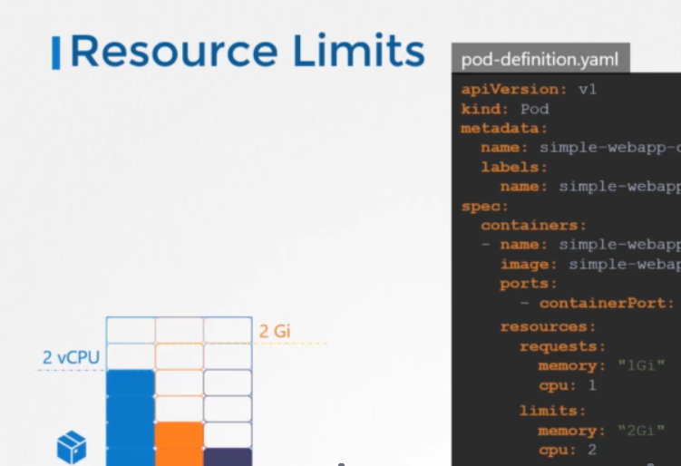
Resource Requirements and limits

Slide 32

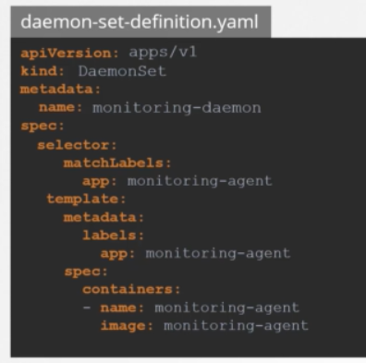
DaemonSets
DaemonSets is used to deploy a same pod across all the available nodes. For Suppoe if we want Zabbix agent in the all the nodes. We can use this as a method so that it deploys pods on all the available nodes.
kubectl -n kube-system get pods | grep weave-net
To get imgae used for Deamon set
Kubectl –n kube-system describe weave-net | grep –i image

Slide 33
Static PODs
Static pods are one which could be directoly deployed by kubelet in that node. i.e, without API server and other master components. Note: we shall only deploy PODS not other objects such Deployments, ReplicaSets, etc. This can be achieved by placing the yaml files inside the node config directory, default one is ‘/etc/Kubernetes/manifests’. We shall many no.of POD yaml files. So that kubelct checks frequently and deploys in the same node accordingly. It checks health of the POD and does restarts. And if future if we make any changes in yaml files, kubelet will delete the existing POD, deploys new POD.
And these static pods are listed in kubectl get pods, but the cant be managed by kube-api server since the owner is kubelet of the node. i.e, cant be delted or edited by master api server. Generally these pods are used to install the kube-master components such etcd, kube-controller, kube-scheduler, incase any thing happened the kubelet will required mechanism
Note: The only way is to get deleted is by deleting yaml files from config path.

Slide 34
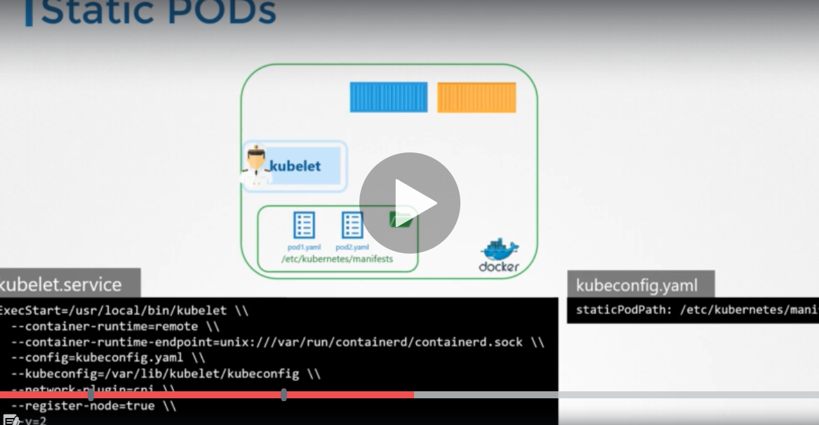
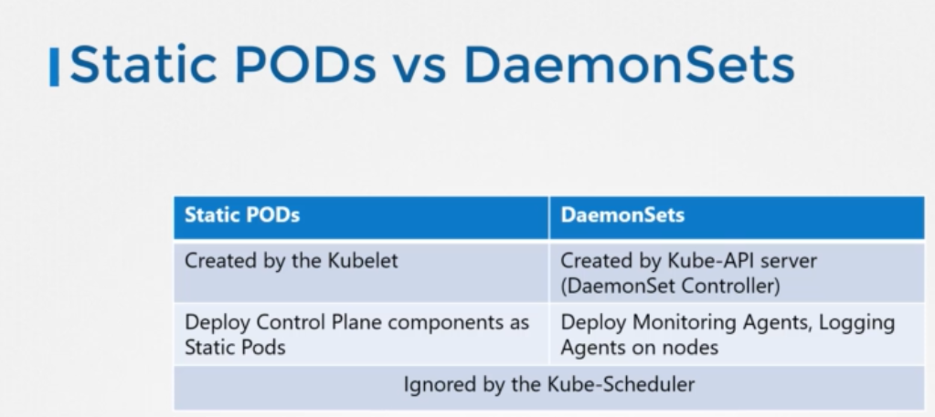
Static PODs

Slide 35
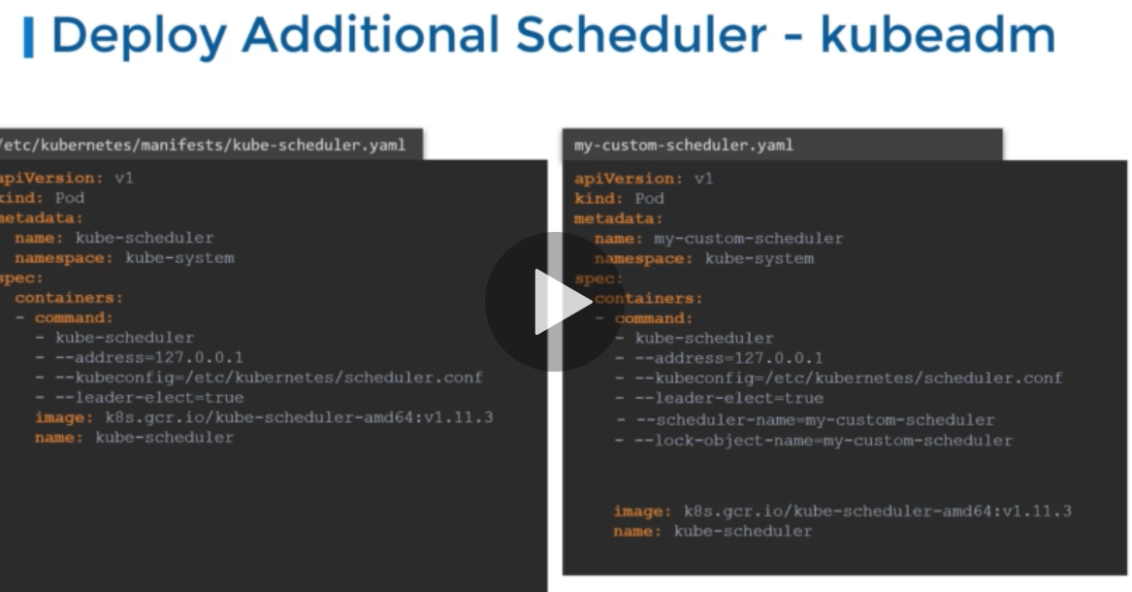
Schedulers: command: kiubectl
Schedulers will schedule the pods based on the different constraints such as default resource, taints & tolerations , node selector and nodeaffinity. We can have multiple schedulers in the node by adding one yaml file under manifests location /etc/Kubernetes/manifests in kube-master. So that we would be having desired kube-schdulers.

Slide 36
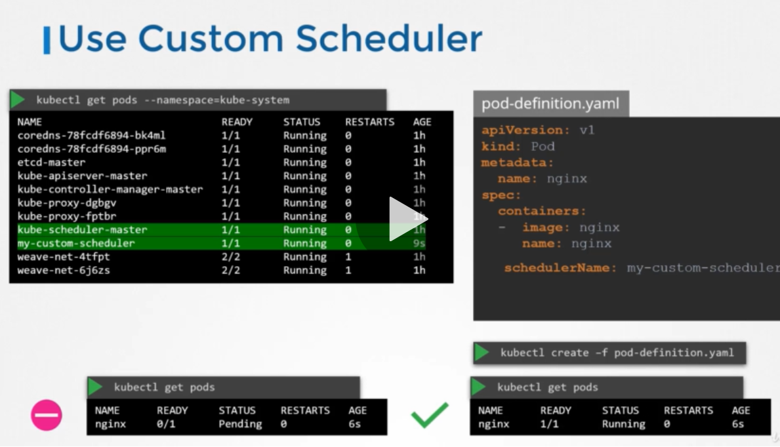
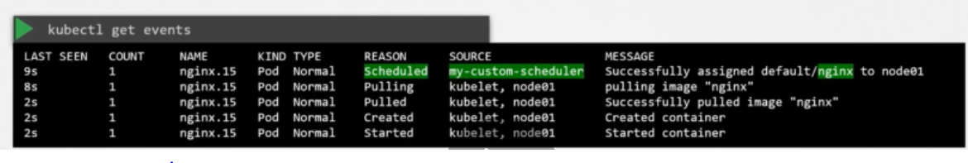
Schedulers
We have leader-elect option which always would be leader in scheduling.
We can specify the scheduler name in spec section to get the required scheduler in yaml file.
To get about the schedudler and pods .
Cmd: kubectl get events
To see the logs of the scheduler
Cmd : kubectl logs SCHEDULER_Name --name-space=kubesystem

Slide 37
Logging & monitoring
Need to install a metric server, this can be done by cloning the appropriate git repo and create a pod.
Commands to get the details:
to get cpu and memory stats :
Kubectl top node/pod
If the pod has multiple containers , wish to see metrics of a container, will go with below cmd
Kubectl top pod_name -c container_name

Slide 38
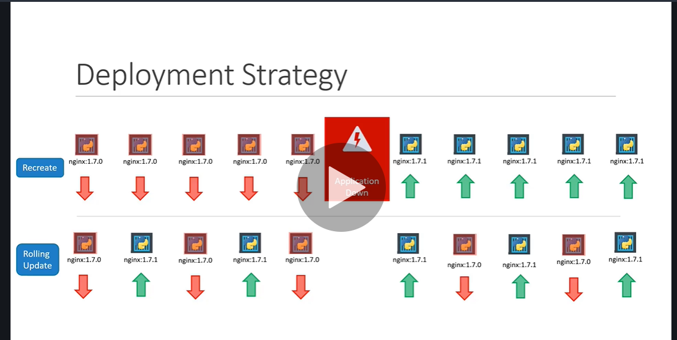
Rollouts and updates
Kubectl rollout status deployment/my-app-deployment
There are two deploymnets startegies one is Recreate, Rolling update. The deault one is ‘Rolling update’

Slide 39
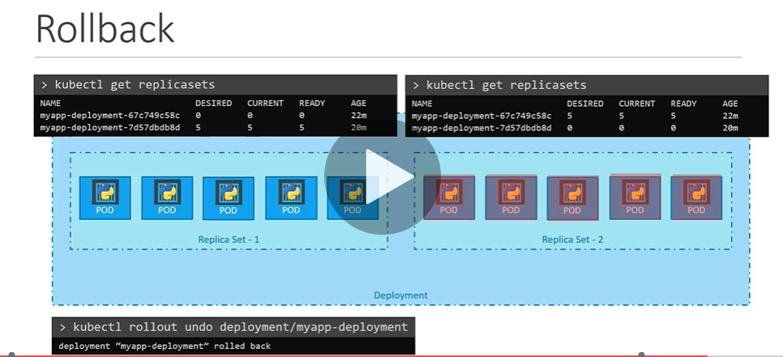
To rollback to the older deployment
Cdm: kubectl rollout undo deployment_name
Note: Rollback and rollout strategies are depends on Deployment strategy , that can be mentioned in yaml file.
The default strategy is “RollingIUpdate”

Slide 40
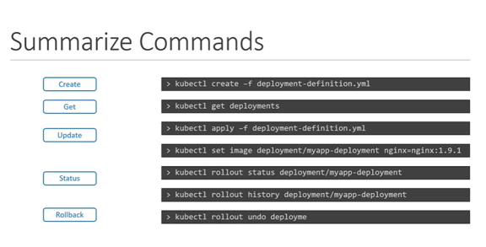

Slide 41
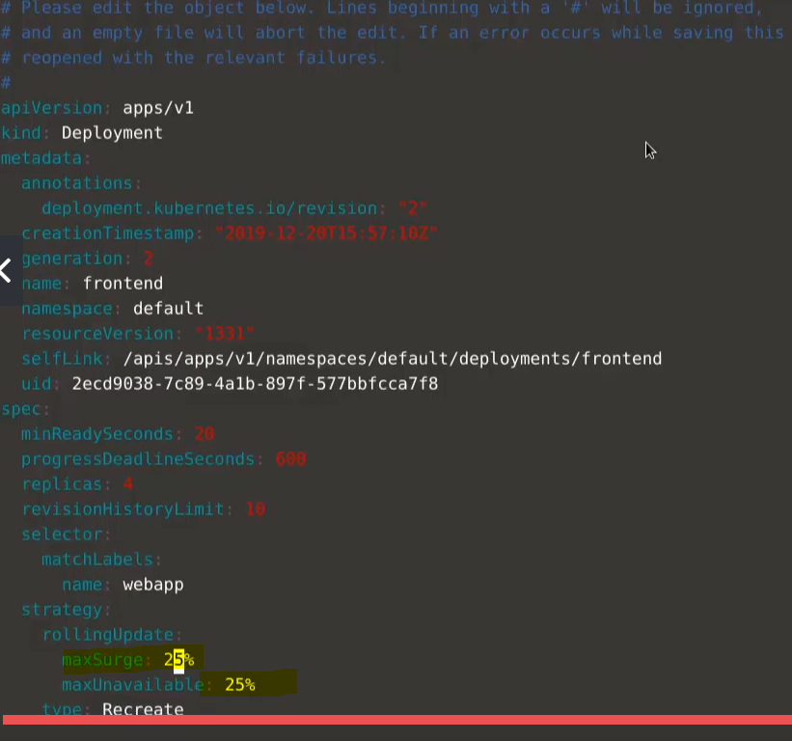
Note: we can set the strategy and and amount of containers available/drains as part of Rolling Update strategy, in the below example, they have set max unavailability is 25 %, that means if we have a replicase is set to 4, then one container can go down and once new container will come.

Slide 42
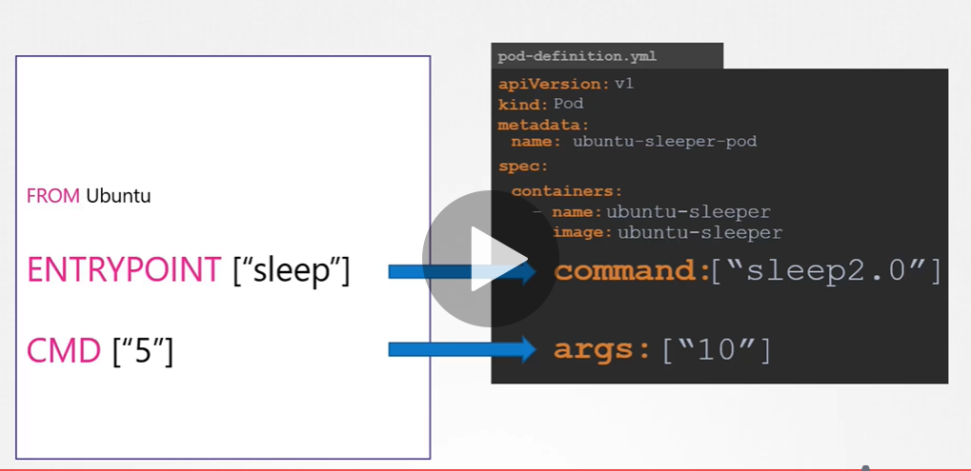
Commands and arguments
We wrote a docker file, that needs an entrypoint instructiona and we would like change entrpoint parameter and its values. That can be done in yaml by specify like below.

Slide 43
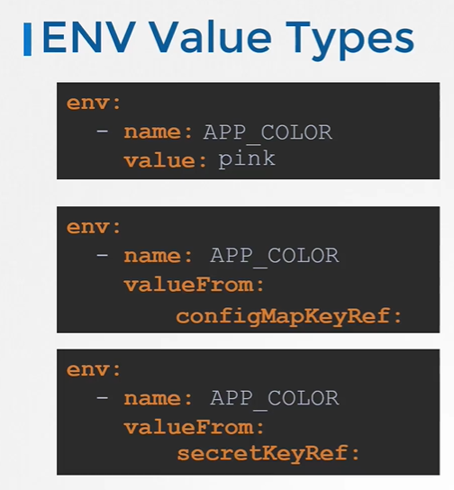
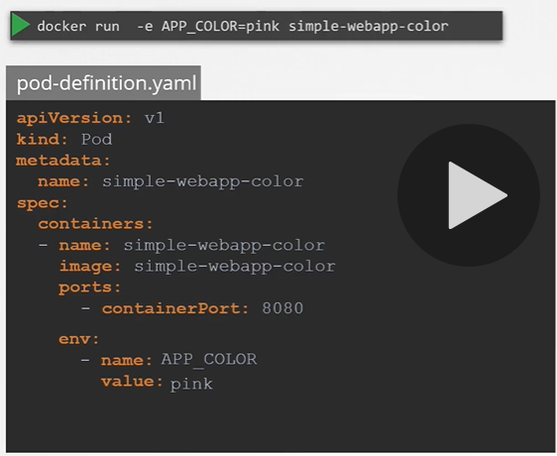

Slide 44
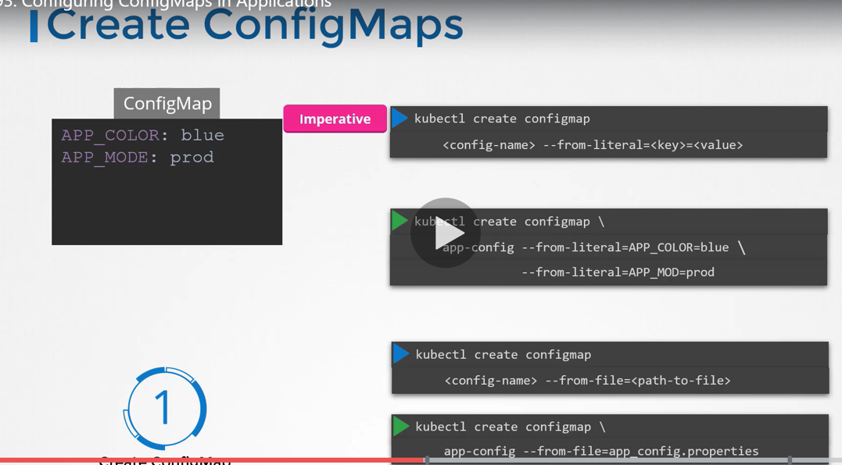
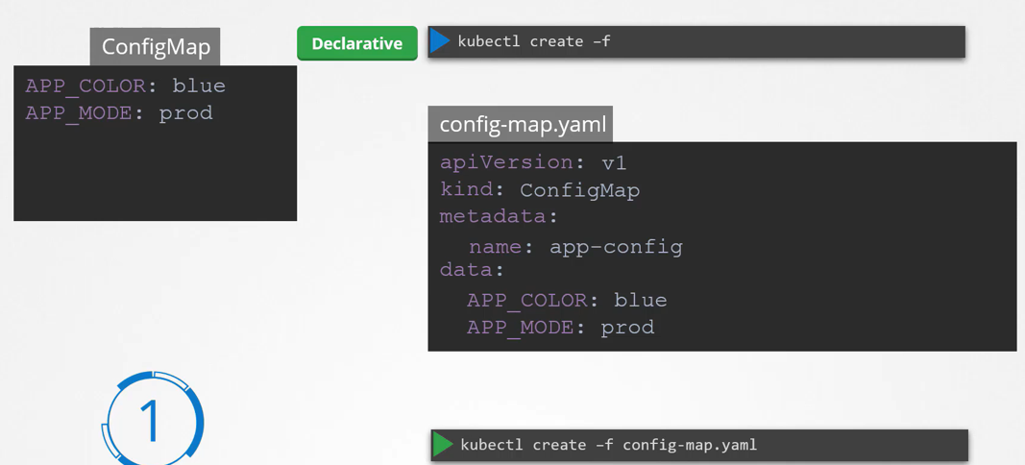

Slide 45
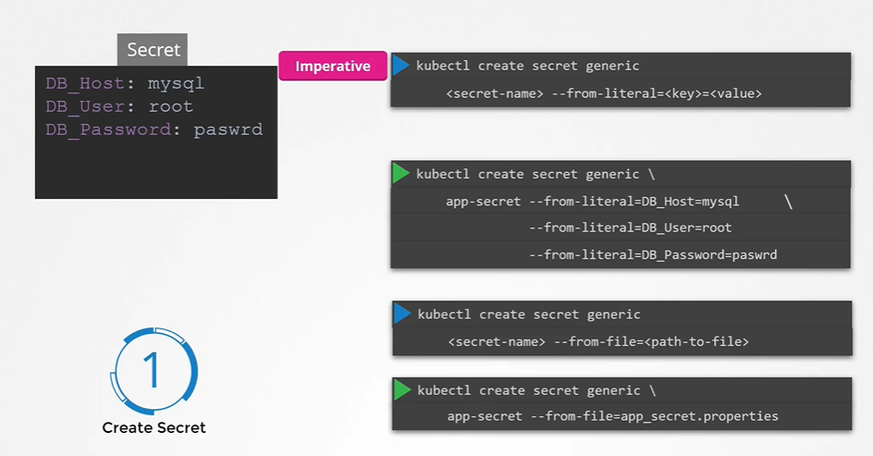
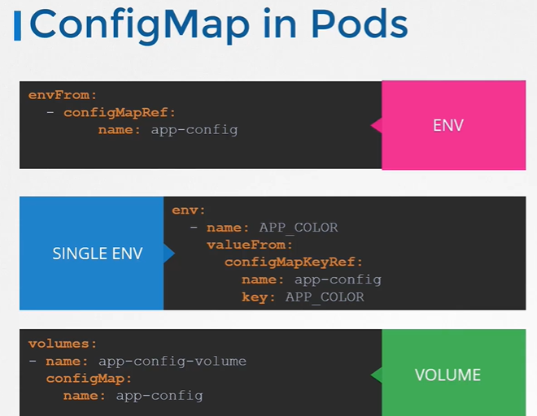

Slide 46
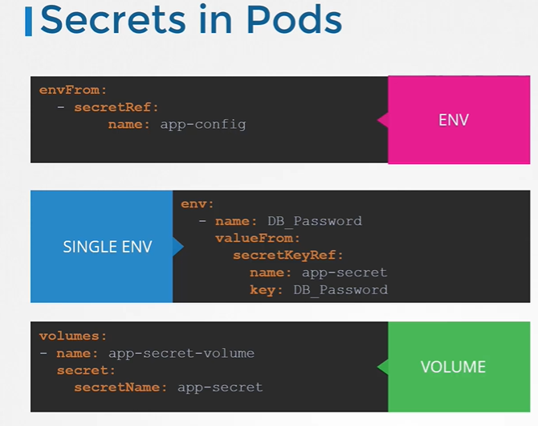
Secrets in kubernetes
Cmd: kybectl get secrets
Kubectl ger configmaps
Kubectl describe secret/config_maps file
We can even encode the passwords, to view that infor
Kubectl get secret app-secret –o yaml (to view encode information)

Slide 47
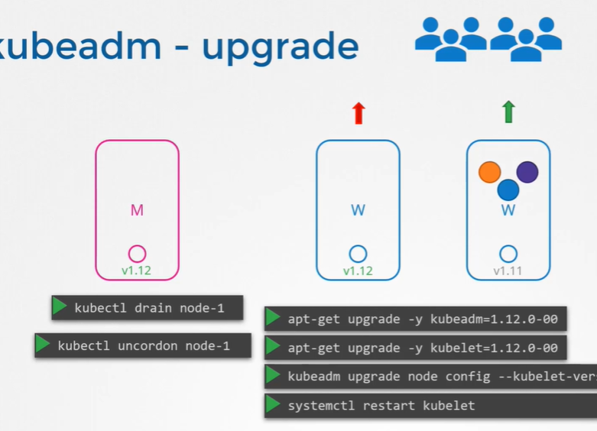
Pod eviction time, is set on controller manager is set default for 5 mins.
After eviction time, it coms without any pods.
We can gracefully drain a node,
Cmd: kubectl drain node_name –ignore-daemonsets
this node is marked as unscheduable.
When it comes back online, we have to uncordon the node to available for schedule.
Cmd: kubectl uncordon node_name
There is one more way to make node as unschedulable
Cmd: kubectl cordon node_name
Kuberenetes upgrade: kubeadm upgrade plan

Slide 48
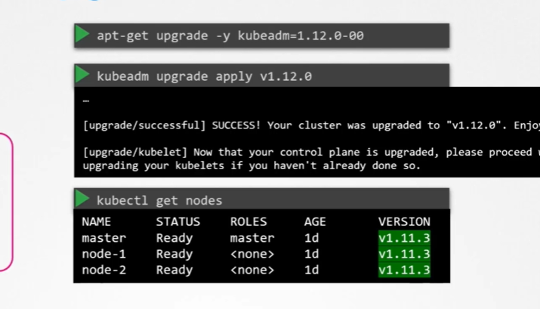
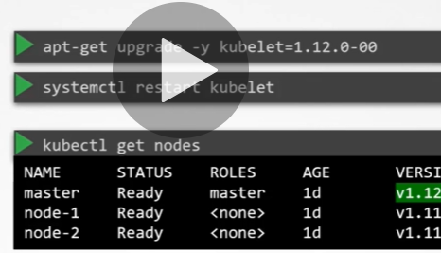
Here what we see is the kubelet version in the green highlighted value
Here kubelet verson of master has been updated
Kubeadm upgrade apply $version

Slide 49
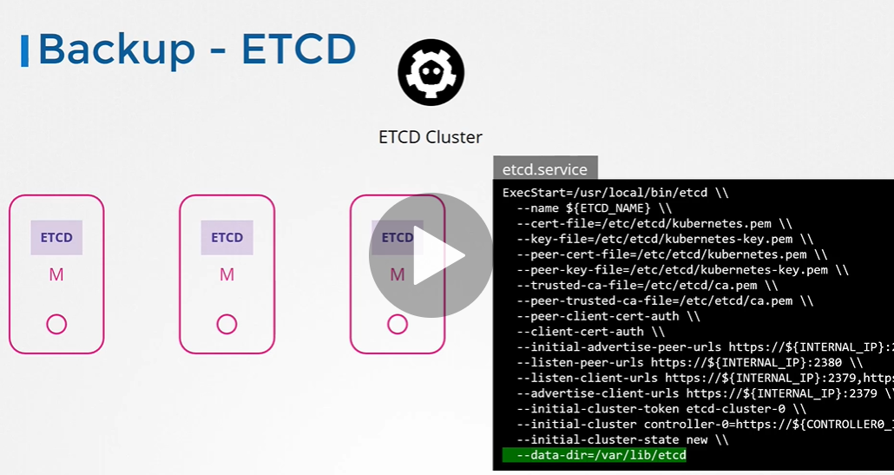
Bakcup and Restore
Backup of ETCD:
ETCD is hosted on master servers. Under the location /var/lib/etcd.

Slide 50



Etcd also comes up the default snapshot mechanism. Using the below commands we can take backup. We can restore the backup by stopping kube -apiserver. Using the specified commands. During the process of restore we need to submit the token which we used in initial set up of cluster

Slide 51


Storage
Persistent volumes
Persistent volume claims
Configure applications with volumes
Access modes for volumes
Kubernetes storage object
Volume types:
Volume mounting: it mounts the docker volumes directory (/var/lib/docker/volumes/volume_name) (-v data_volume:/var/lib/mysql). This volume can be also created during runtime.
Bind mounting: it mounts the volumes what ever we specify the location(ex: -v /data/mysql:/var/lib/mysql)
There is another way of syntax: --mount
Docker uses layered architecture, for ex: If we speficy ubantu image with specifica version on two or more docker files. It downloads only one time and this used in the other images for creating continaers. We can use different storage drivers
Ex: AUFS | ZFS | BTRFS| DEVICE MAPPER | OVERLAY.
And volumes are maintained by volume driver plugins. We can even store them saws ebs other storages.

Slide 52





Slide 53


Kubectl get persitentvolume
Kubectl get persistentvolumeclaim
Persistent volume is defining separate mount volume point by administrators.
Persisteant volume claim is the user defined volume for his applications from persistent volume.
To delete the persistent volume claim
Kubectl delete persistent volume claim cliam_name.
There is an option for claiming the volume after deletion. We can specify in yaml file
persistentvolumeReclaimPolicy: Delete/Recycle/Retains
Ref: https://kubernetes.io/docs/concepts/storage/persistent-volumes/#claims-as-volumes

Slide 54

Security
Controlling access to API-Server.
We are having multiple methods to authorize the api-server such as , passwords, token, third-party tools. Passwords, tokens we’ll store in a csv file and point to the location kube-api yaml or conf file.
--basic-auth-file=path
--token-auth-file=path

Slide 55



